Slide 1

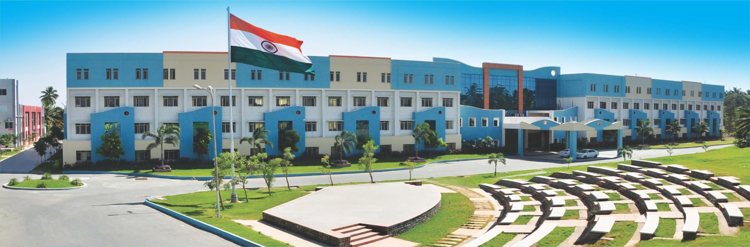
Module I: Software Process
Software Engineering

Slide 2
Module I: SOFTWARE PROCESS MODEL
SDLC- SDLC Models-Overview of Agile Development Models: Scrum - Scrum Roles - Scrum Meetings - Scrum Artifacts - Extreme Programming, Feature Driven Development, Kanban and Lean Software Development - DevOps and benefits.Case Study: SDLC followed in MNCs ( Infosys, CTS, Google, etc..)

Slide 3
Course Outcomes:
CO1 : Compare the various software process models and select the suitable model. (K3 Apply)
CO2 : Analyze the complexity of the project and develop the project plan. (K4 Analyze)
CO3 : Construct the UML diagrams for a project using software design methodology.(K3 Apply)
CO4 : Analyze and apply the appropriate software testing strategy in the chosen project.(K4 Analyze)
CO5 : Demonstrate the knowledge on contemporary tools in software engineering.(K3 Apply)

Slide 4

Agenda:
Software Process
Layered Technology
Generic Process Framework
Umbrella Activities

Slide 5
Software Process
A process is a collection of
Activities,
Actions and
Tasks
that are performed when some work product is to be created.
An activity strives to achieve a broad objective and is applied regardless of application domain, size of the project, complexity of effort.

Slide 6
Cont..,
An action (e.g., architectural design) encompasses a set of tasks that produce a major work product e.g., An architectural design model
A task focuses on a small, but well – defined objective that produces a tangible outcome.

Slide 7

Layered Technology
Any software can be developed using these layered approach.

Slide 8
Cont..,
Process layer foundation defines a framework with activities for effective delivery of software engineering technology. Establish the context where products (model, data, report, and forms) are produced, milestone are established, quality is ensured and change is managed.
Method provides technical how-to’s for building software. It encompasses many tasks including communication, requirement analysis, design modeling, program construction, testing and support.
Tools provide automated or semi-automated support for the process and methods.

Slide 9
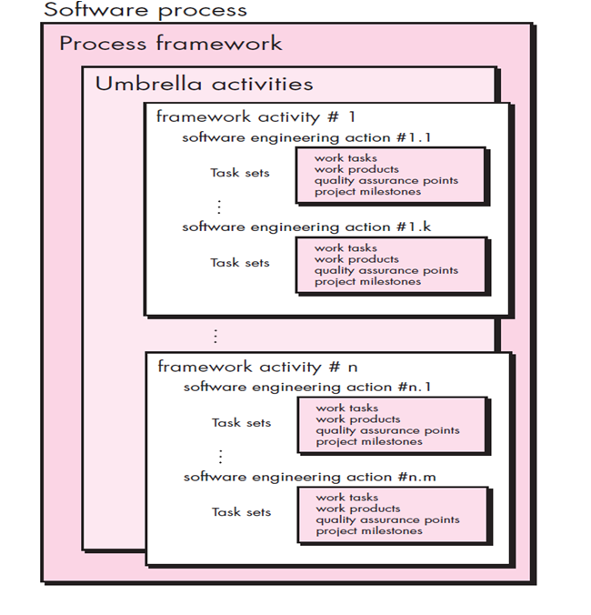
Generic Process Framework

Slide 10
Generic Process Framework
Communication
Involves communication among the customer and other stake holders; encompasses requirements gathering
Planning
Establishes a plan for software engineering work; addresses technical tasks, resources, work products, and work schedule
Modeling (Analyze, Design)
Encompasses the creation of models to better understand the requirements and the design

Slide 11
Cont..,
Construction (Code, Test)
Combines code generation and testing to uncover errors.
Deployment
Involves delivery of software to the customer for evaluation and feedback

Slide 12
Umbrella Activities
It occur throughout the process. It focus on project management, tracking and control. Some activities are:
Software project tracking and control
Risk management
Software quality assurance
Technical reviews
Measurement – process, project, product
Software configuration management
Reusability management (Component Reuse)
Work product preparation and production

Slide 13
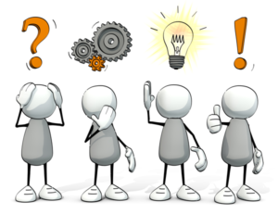

Slide 14


